Slide 1


MINI PIANO USING ARDUINO
Khushi Jha (2019BTCS036)

Slide 2

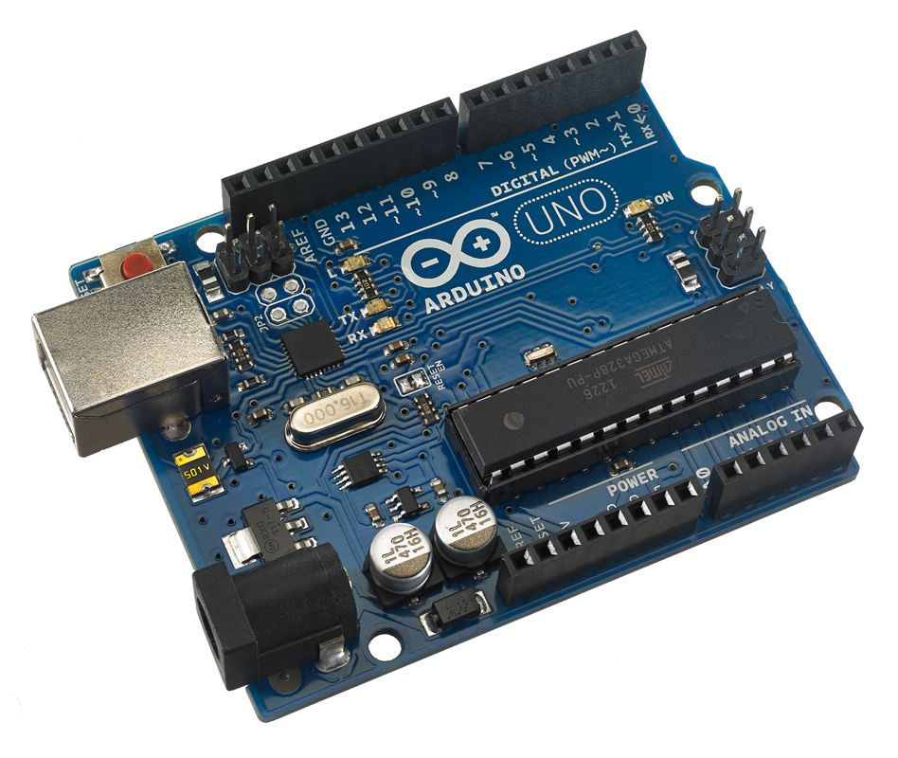
INTRODUCTION TO ARDUINO
Arduino is an open-source electronics platform based on easy-to-use hardware and software.
Arduino Boards are able to read inputs - light on a sensor, a finger on a button, or a Twitter message - and turn it into an output - activating a motor, turning on an LED or publishing something online.

Slide 3
The reasons behind people preferring Arduino over others are:
Inexpensive
Cross-platform
Simple and clear programming environment
Open source and extensive software

Slide 4
Introduction to Project:
The project is Mini Piano using Arduino, this piano is pretty much plain with just 7 push buttons and 8 ohm speaker. Mini Piano is a musical device which play tunes of different frequency. This mini piano is made with 7 customizable buttons allowing you to play any frequency and tone you want. It uses the tone () function of Arduino to create various types of piano notes on the speaker.

Slide 5
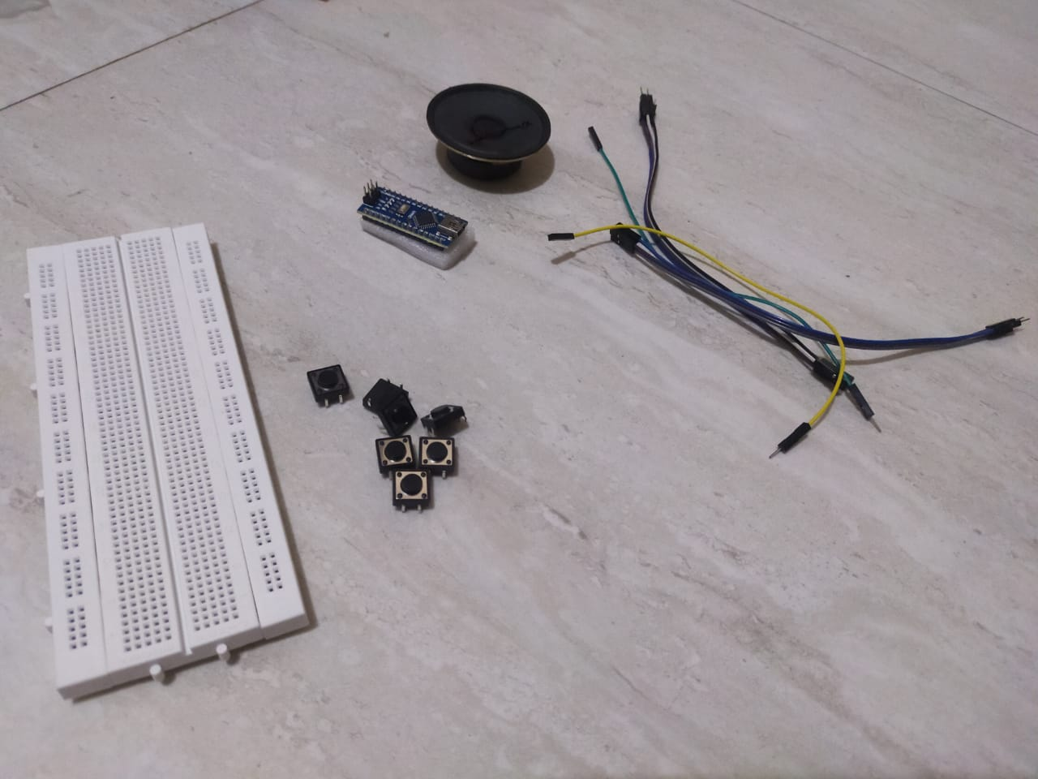
COMPONENTS:
The list of components required to build the project is as follows:
Arduino Nano R3
Breadboard
7 * Push Button switches
8 ohm Speaker
Cable
18 * Jumper wires

Slide 6
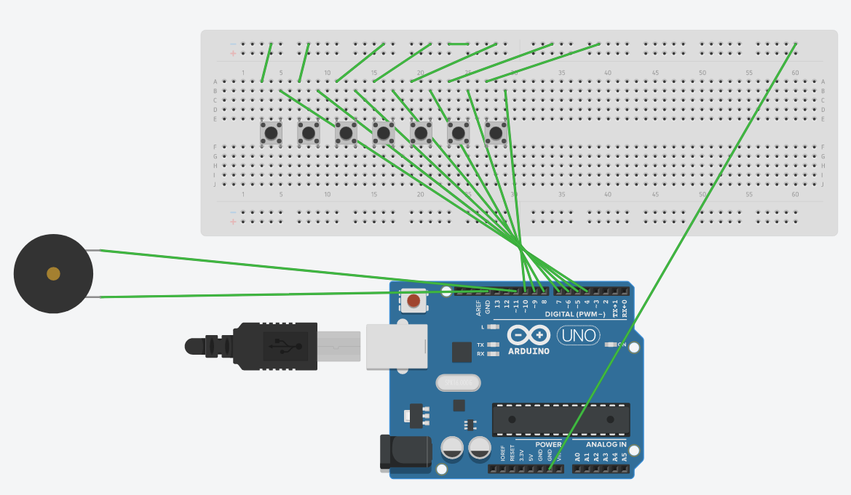
Circuit Diagram
The wiring of the circuit goes in the following steps as mentioned:
| Button | Arduino Nano |
|------------|-------------|
| Button 1 | D4 |
| Button 2 | D5 |
| Button 3 | D6 |
| Button 4 | D7 |
| Button 5 | D8 |
| Button 6 | D9 |
| Button 7 | D10 |

Slide 7
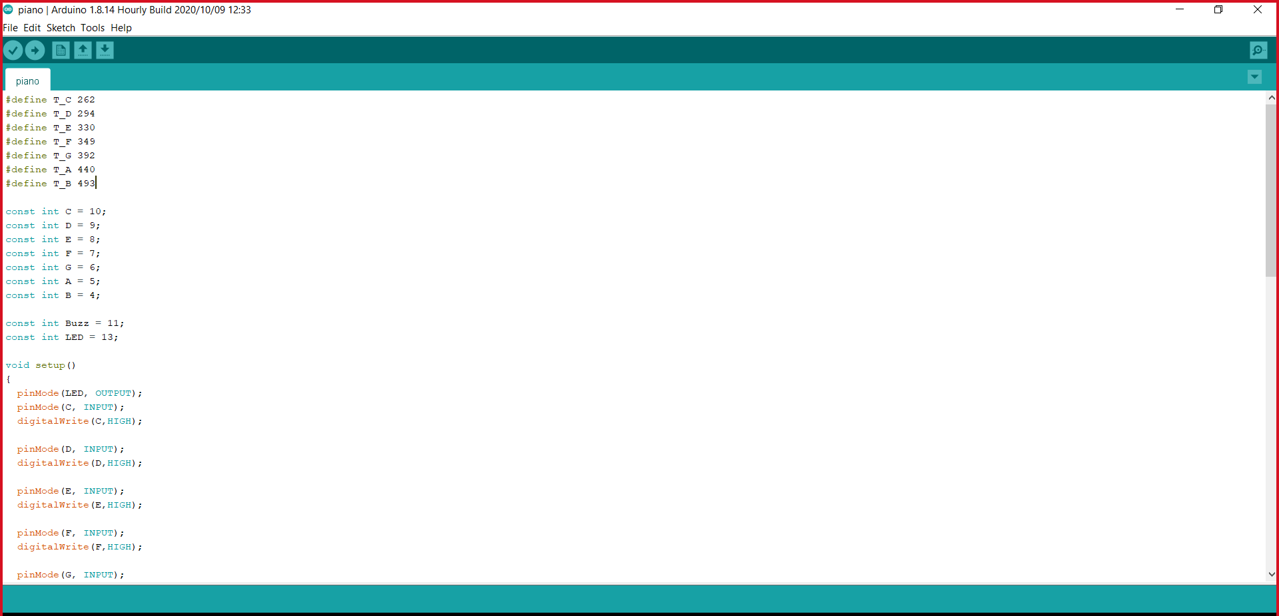
Code
#define T_C 262
#define T_D 294
#define T_E 330
#define T_F 349
#define T_G 392
#define T_A 440
#define T_B 493
const int C = 10;
const int D = 9;
const int E = 8;
const int F = 7;
const int G = 6;
const int A = 5;
const int B = 4;
const int Buzz = 11;
const int LED = 13;

Slide 8
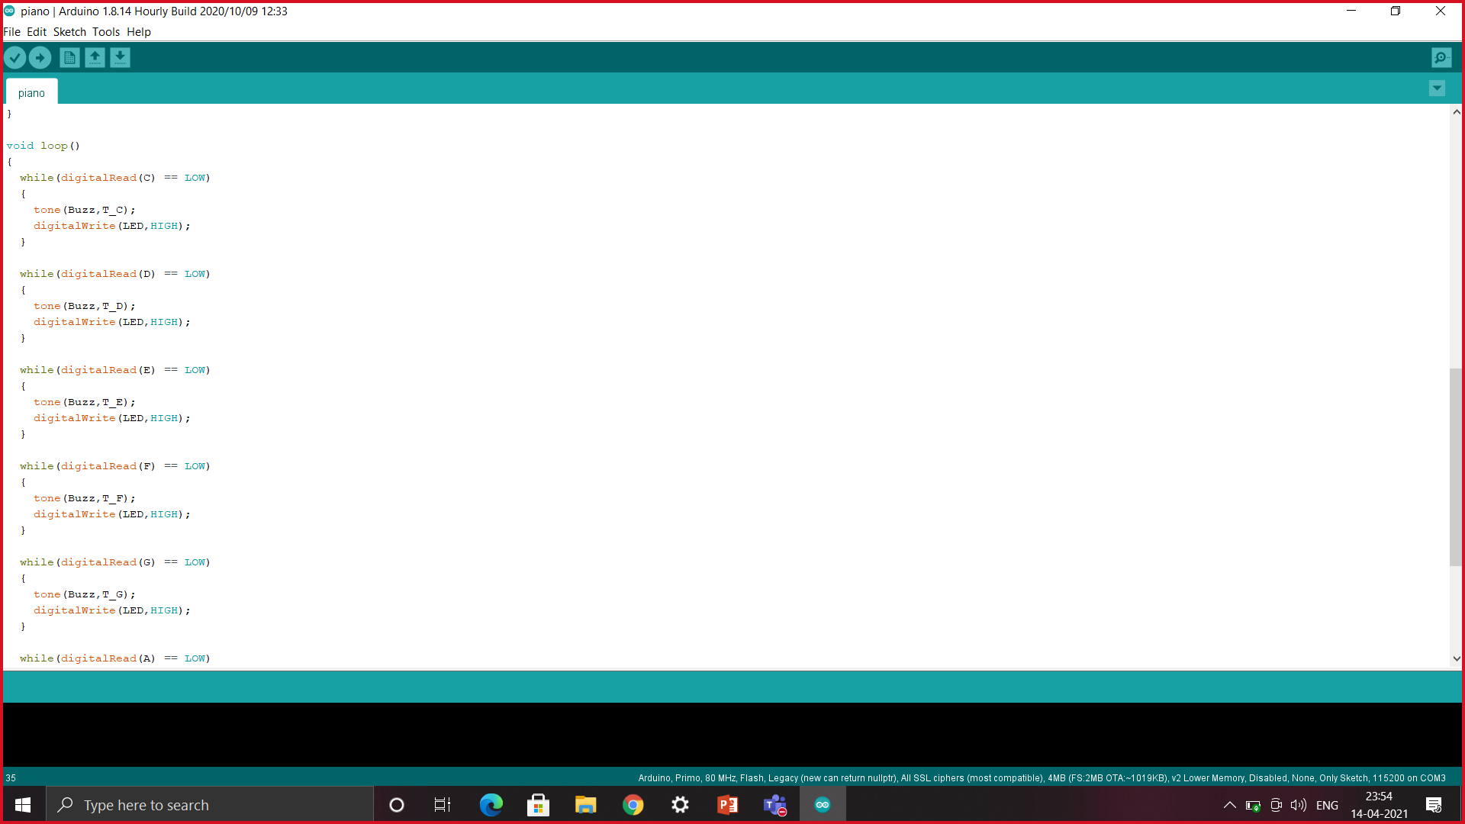
void setup()
{
pinMode(LED, OUTPUT);
pinMode(C, INPUT);
digitalWrite(C,HIGH);
pinMode(D, INPUT);
digitalWrite(D,HIGH);
pinMode(E, INPUT);
digitalWrite(E,HIGH);
pinMode(F, INPUT);
digitalWrite(F,HIGH);
pinMode(G, INPUT);
digitalWrite(G,HIGH);
pinMode(A, INPUT);
digitalWrite(A,HIGH);
pinMode(B, INPUT);
digitalWrite(B,HIGH);
digitalWrite(LED,LOW);
}

Slide 9
void loop()
{
while(digitalRead(C) == LOW)
{
tone(Buzz,T_C);
digitalWrite(LED,HIGH);
}
while(digitalRead(D) == LOW)
{
tone(Buzz,T_D);
digitalWrite(LED,HIGH);
}
while(digitalRead(E) == LOW)
{
tone(Buzz,T_E);
digitalWrite(LED,HIGH);
}
while(digitalRead(F) == LOW)
{
tone(Buzz,T_F);
digitalWrite(LED,HIGH);
}
while(digitalRead(G) == LOW)
{
tone(Buzz,T_G);
digitalWrite(LED,HIGH);
}
while(digitalRead(A) == LOW)
{
tone(Buzz,T_A);
digitalWrite(LED,HIGH);
}
while(digitalRead(B) == LOW)
{
tone(Buzz,T_B);
digitalWrite(LED,HIGH);
}
noTone(Buzz);
digitalWrite(LED,LOW);
}

Slide 10
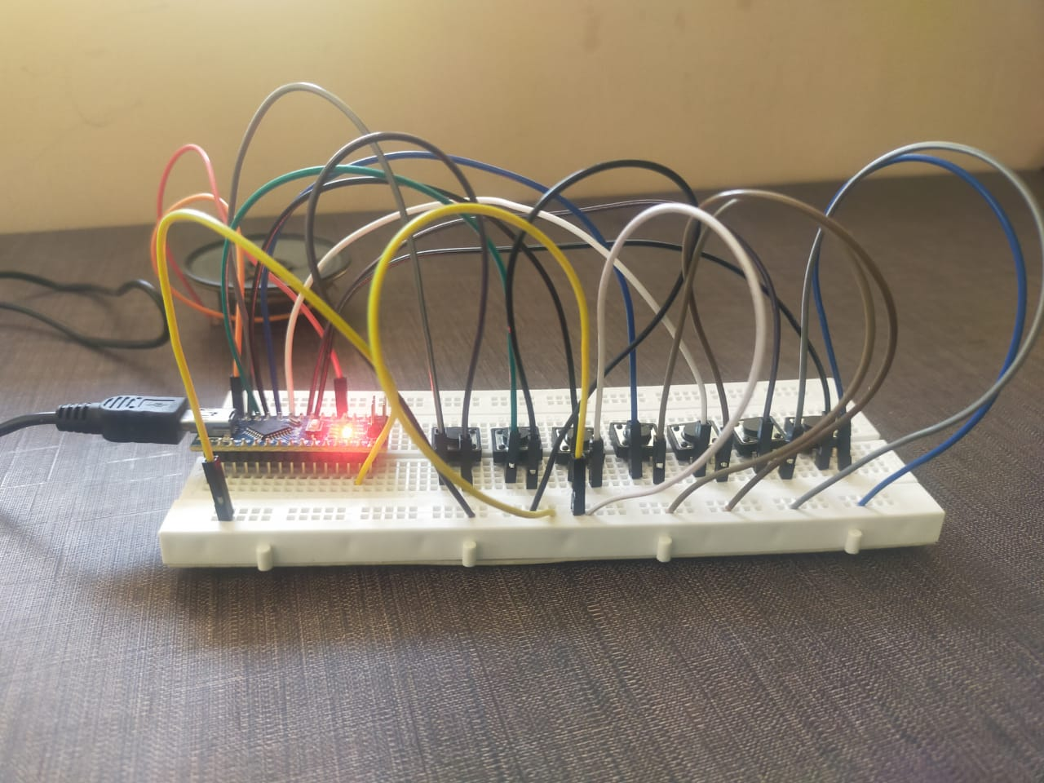
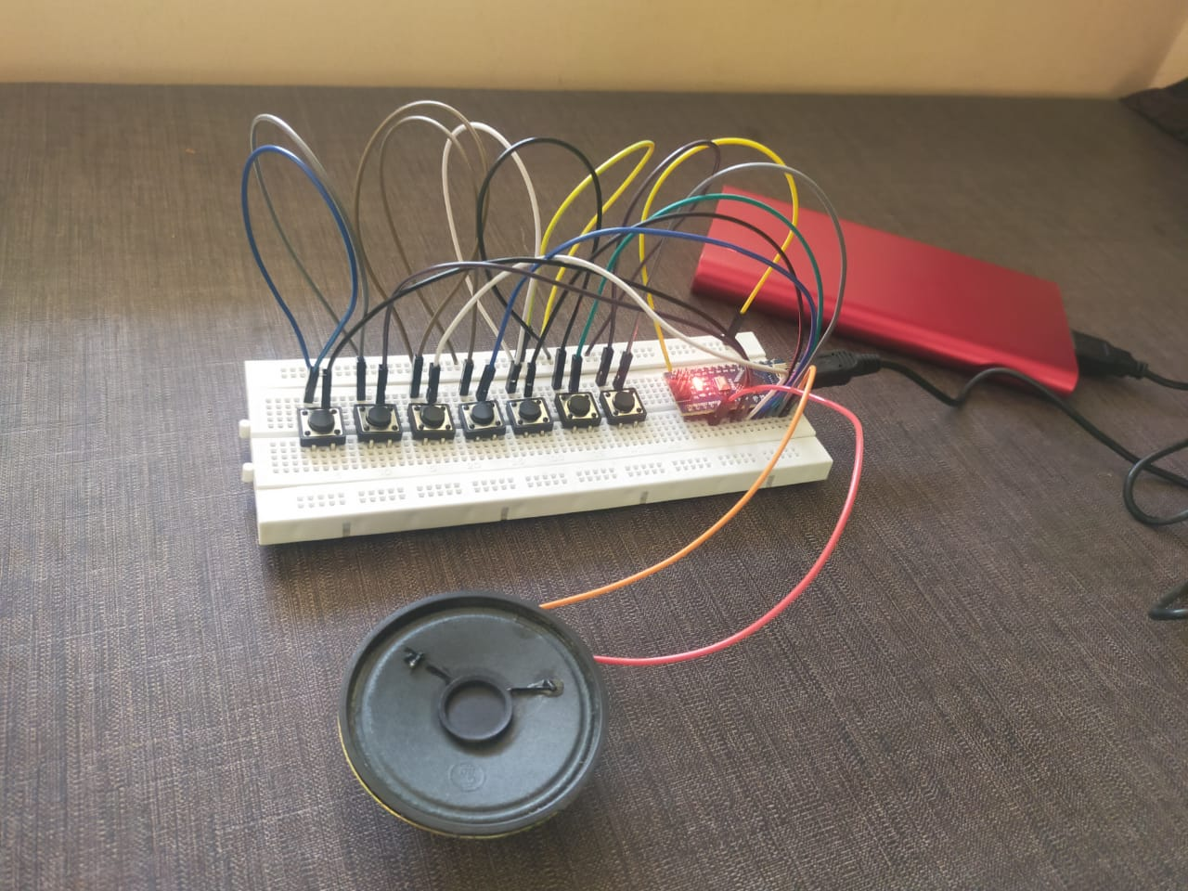
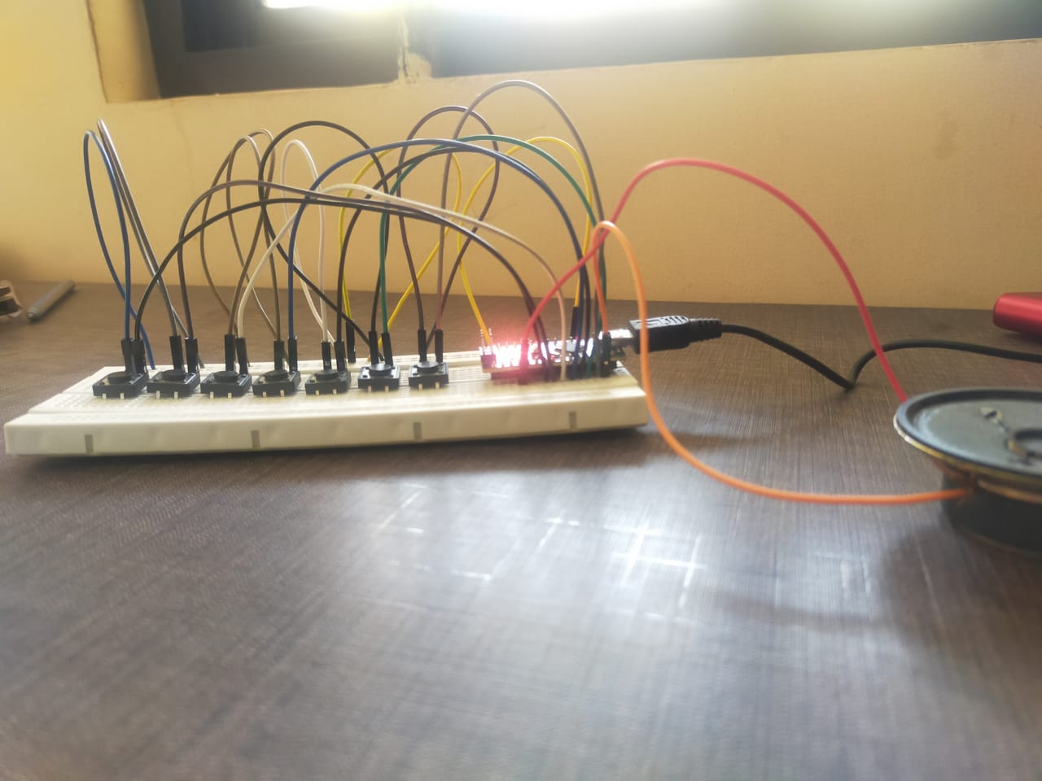
IMAGES

Slide 11
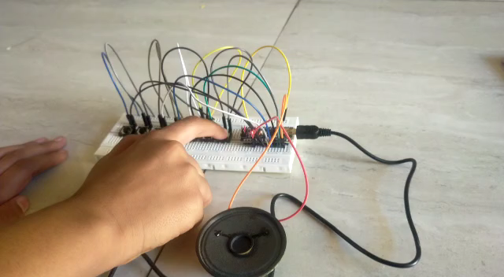

Slide 12
THANKYOU

